Slide 1
Lesson 2

Slide 2
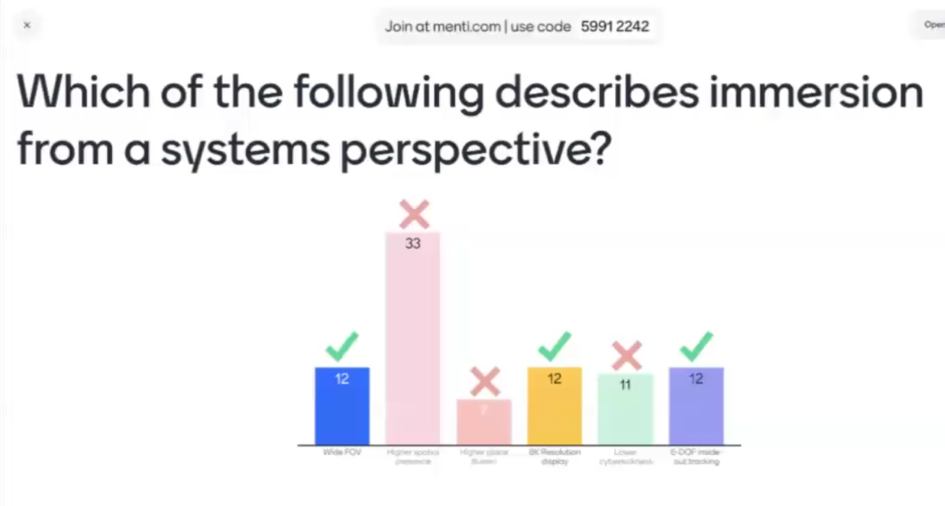
Wide FOV
8K resolution Display
??

Slide 3
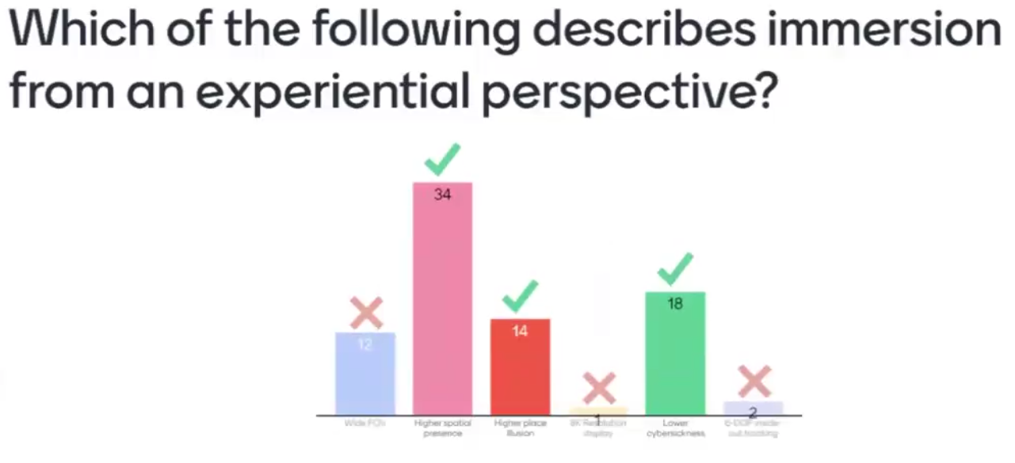
Higher Spatial Prescence
Higher place illuision
Lower cybersickness

Slide 4
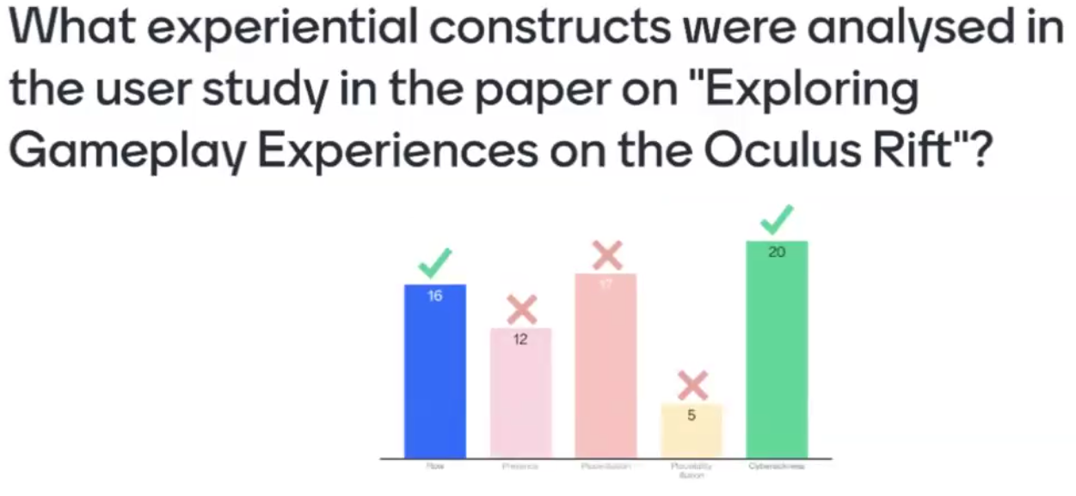
flow
cybersickness

Slide 5
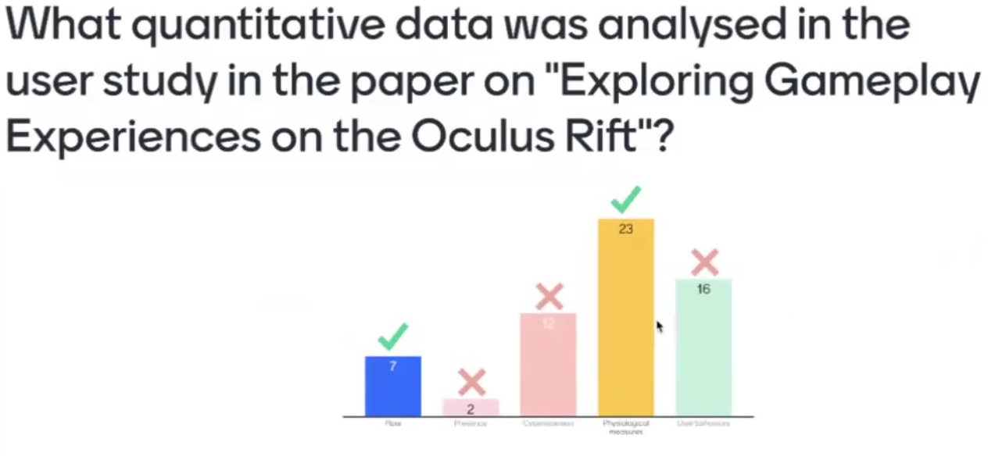
flow
Psychological measure

Slide 6
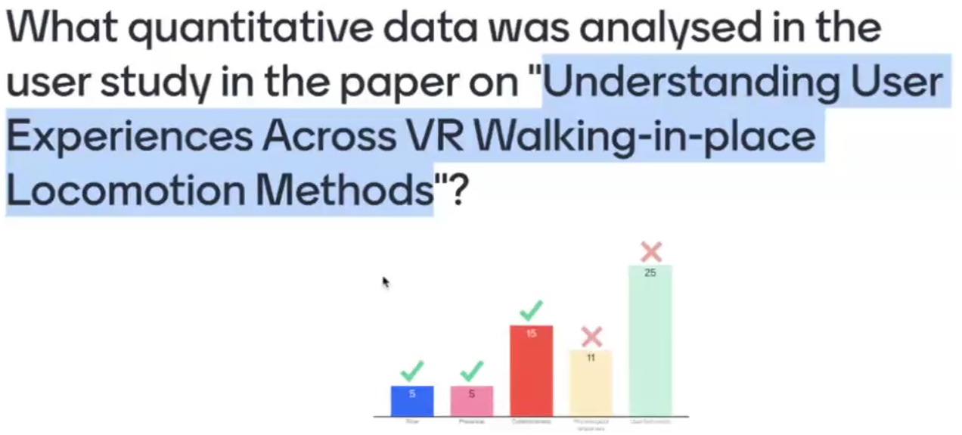
Flow
FSS
Prescence
IPQ
Cybersickness
VRSQ

Slide 7
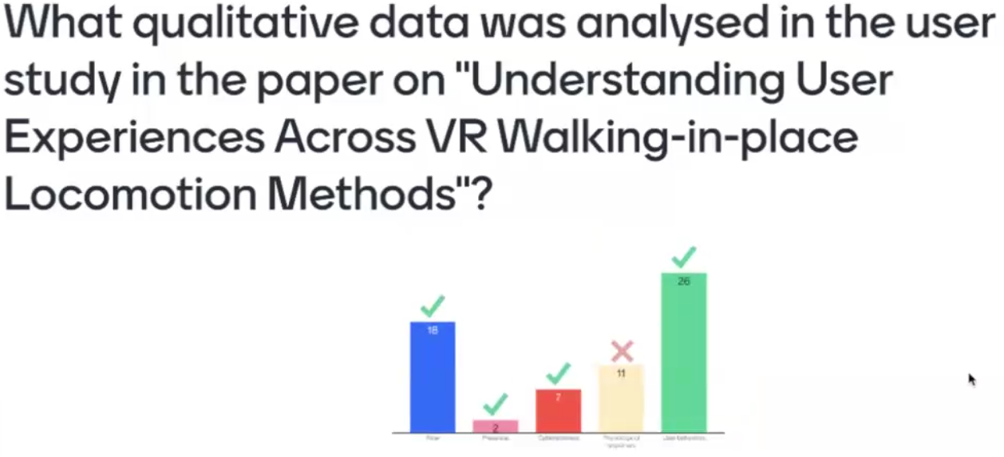
Flow
Prescence
Cybersickness
Experiential

Slide 8
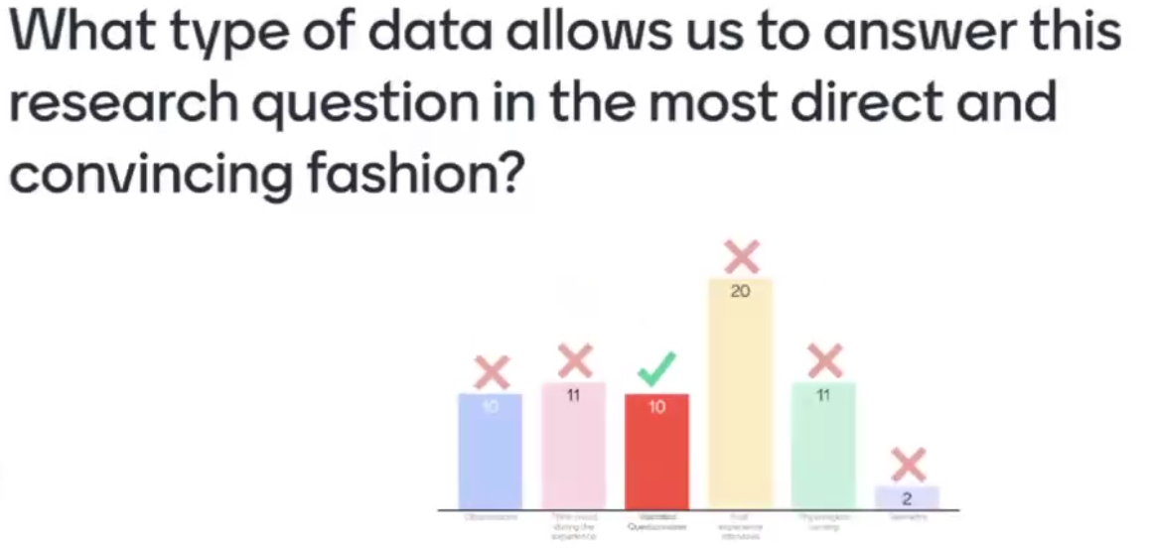
Validated questionnaire

Slide 9
Quantitative datas
Post experience interview
Psychological sensing
observations
interview
Validated questionnaire

Slide 10
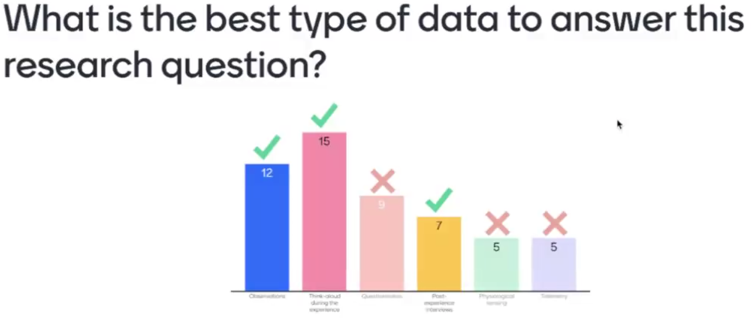
Post experience interview
Psychological sensing
Testimony
observations
interview
Validated questionnaire

Slide 11
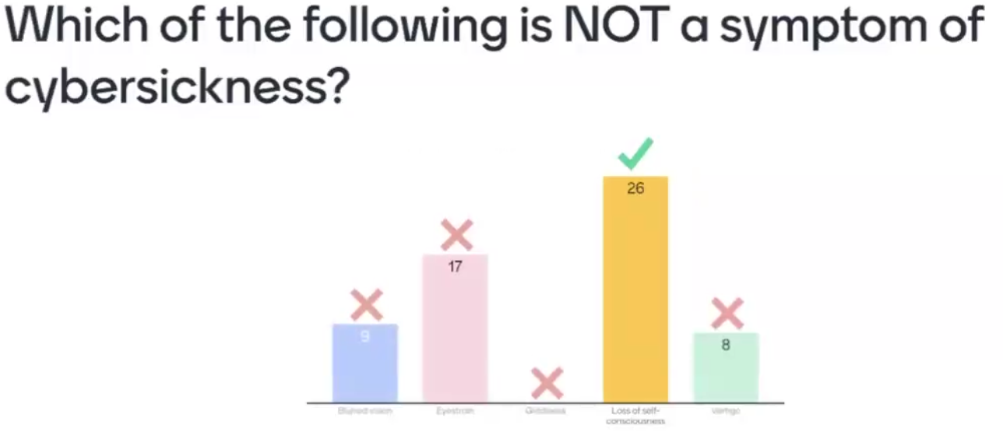
Loss of self-consciousness

Slide 12
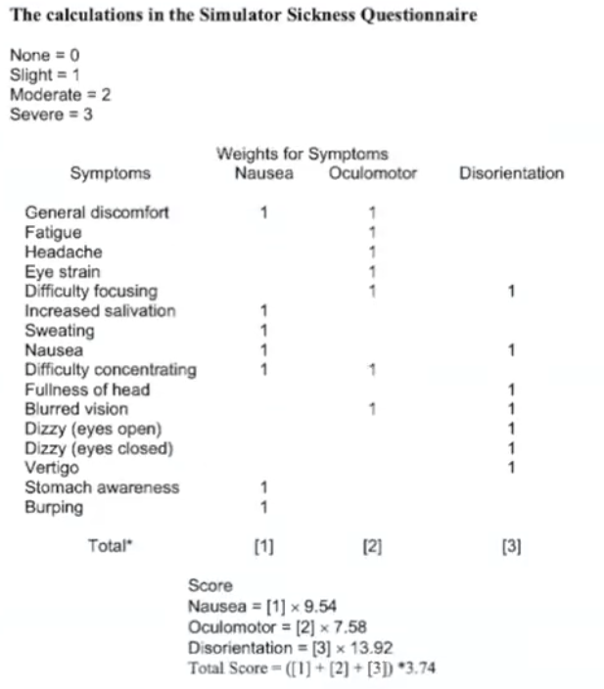

Slide 13
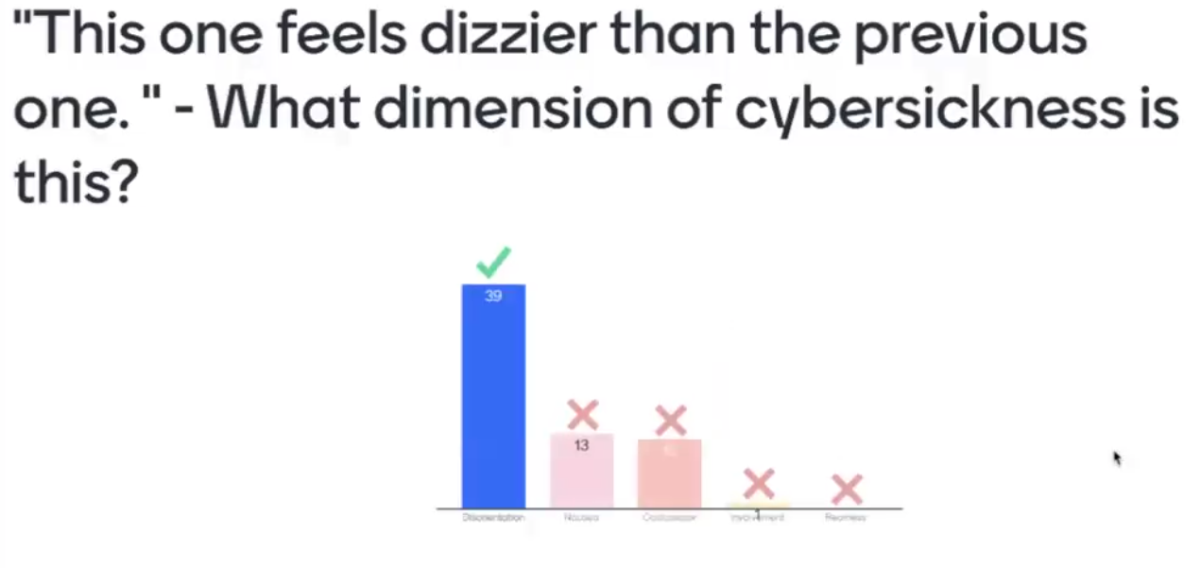
Disorientation

Slide 14
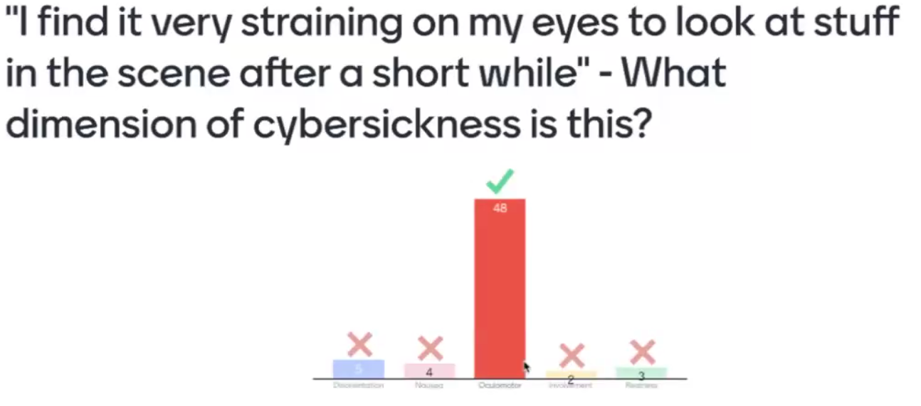
Oculomotor

Slide 15
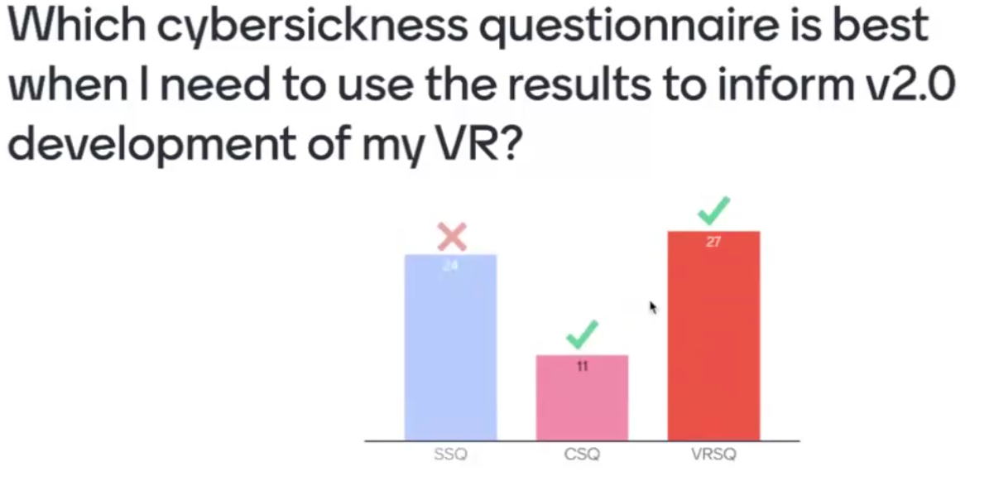
Cyber Sickness Q’nnaire
VR Sickness Q’nnaire

Slide 16
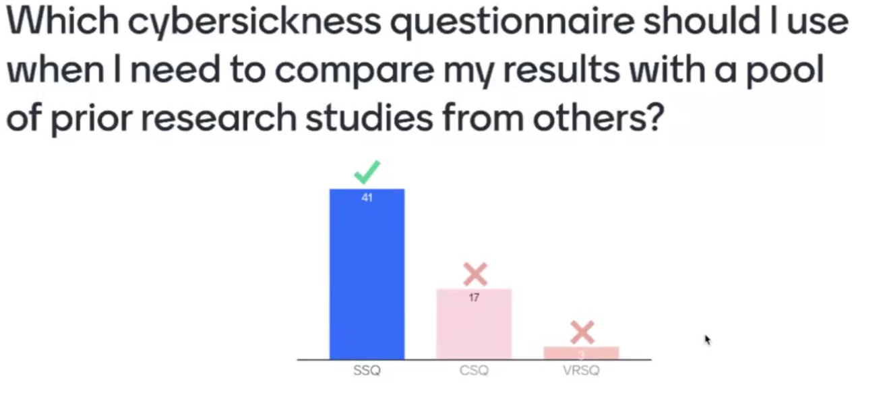
For Screens

Slide 17
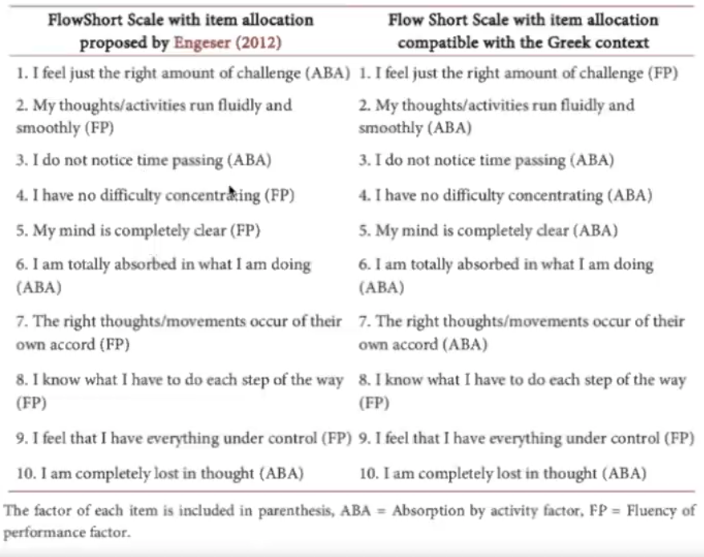

Slide 18
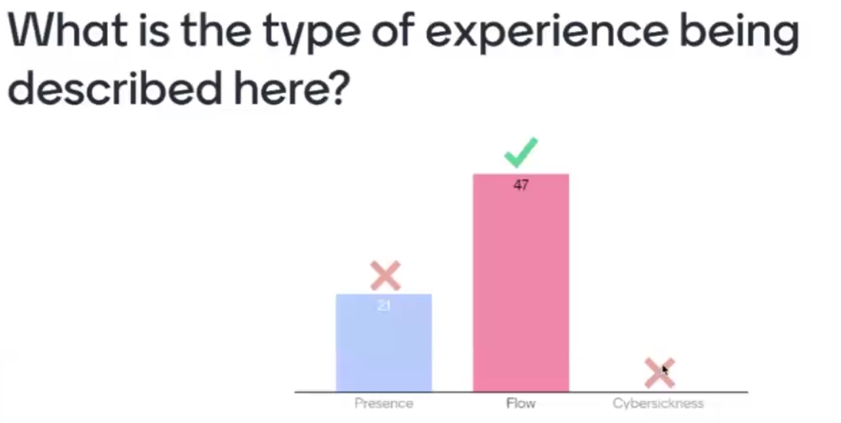

Slide 19
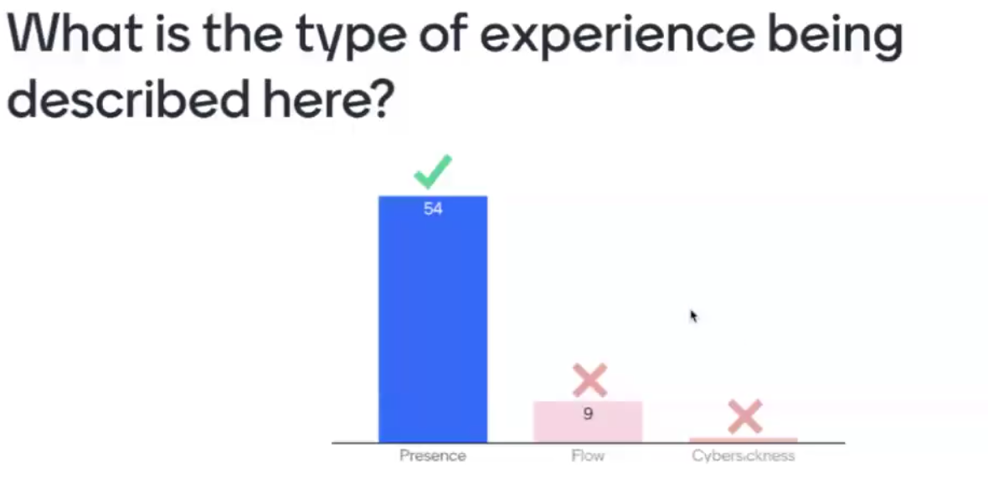

Slide 20
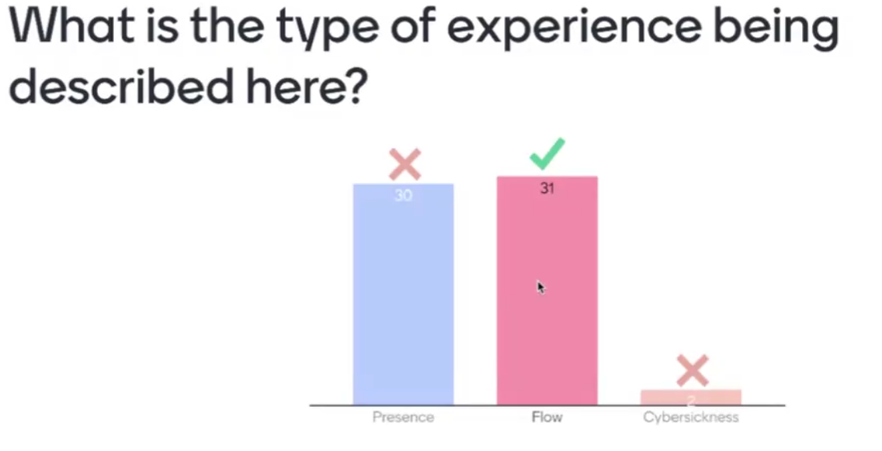

Slide 21
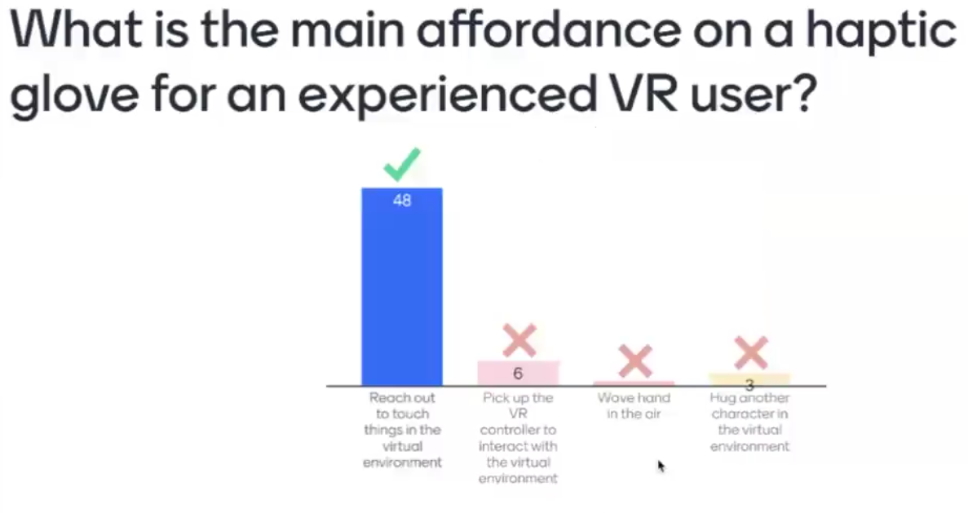

Slide 22
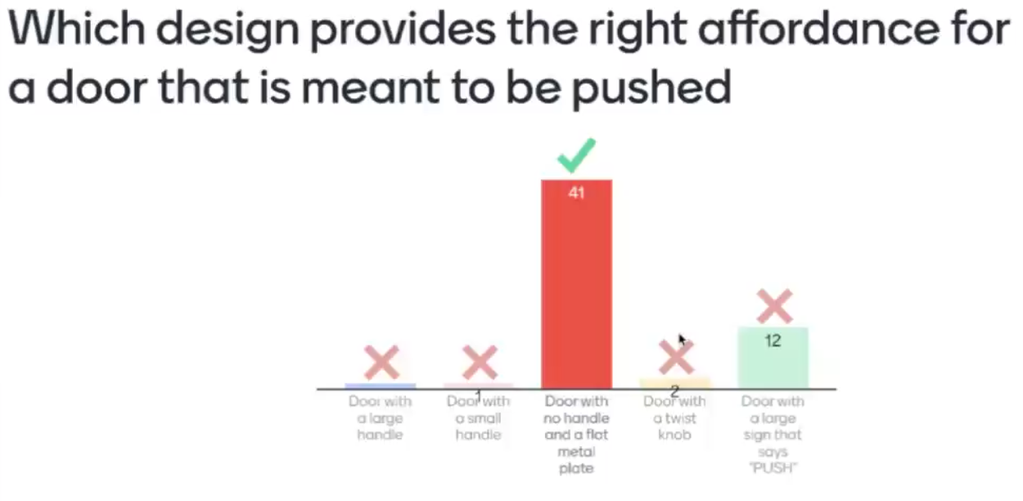

Slide 23
Lesson 4

Slide 24
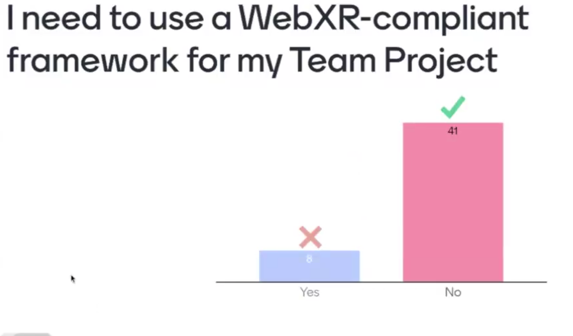
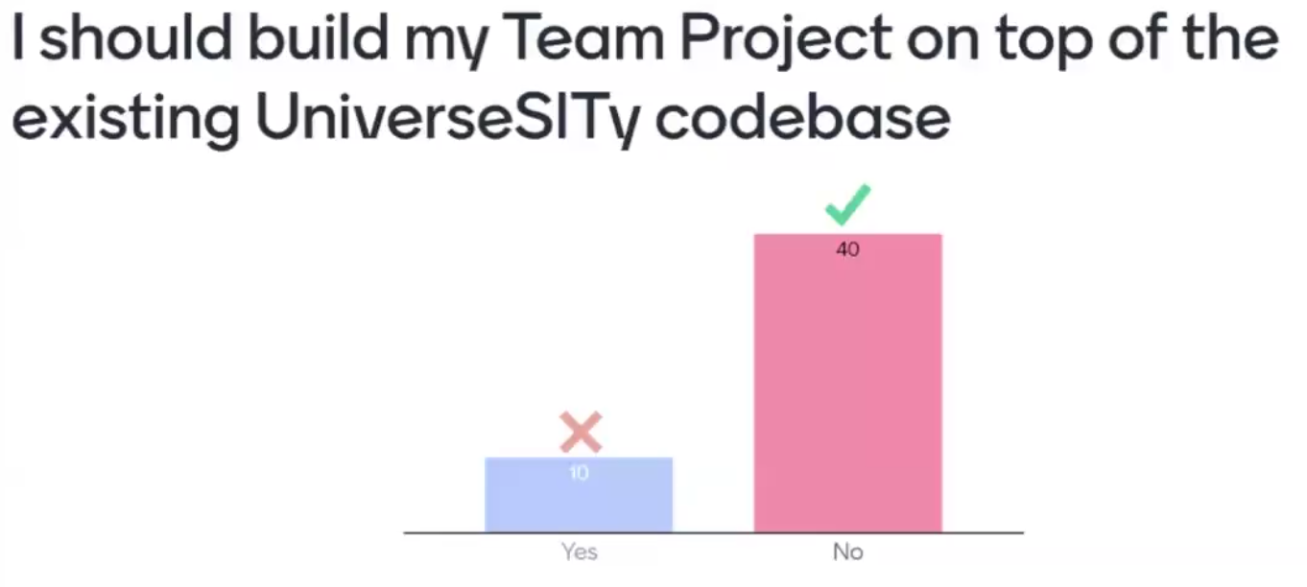
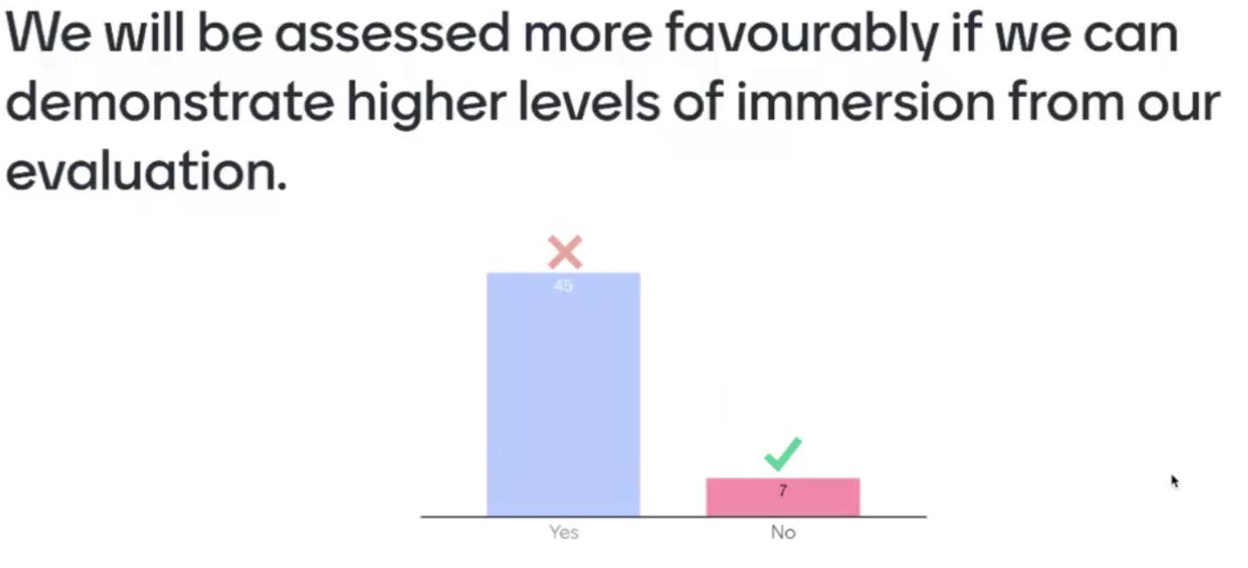
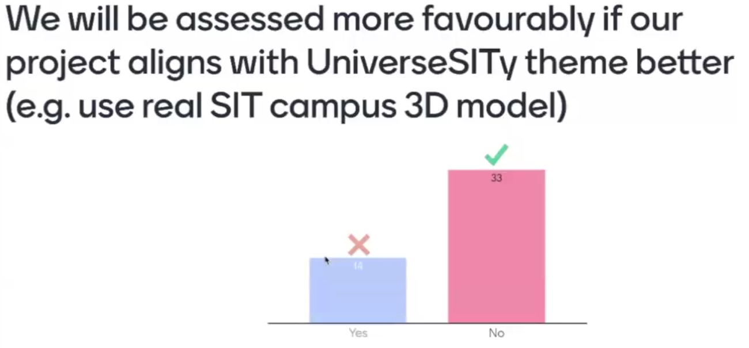

Slide 25
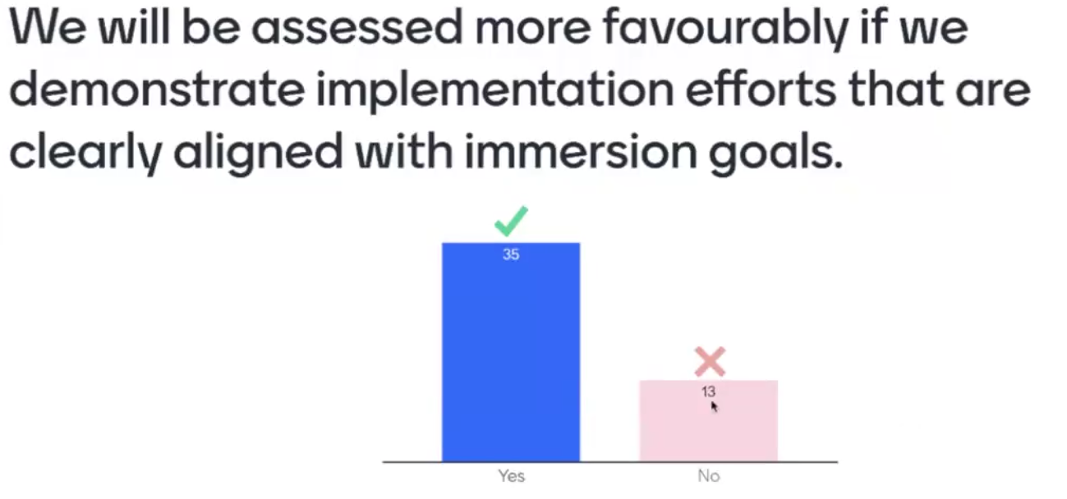

Slide 26
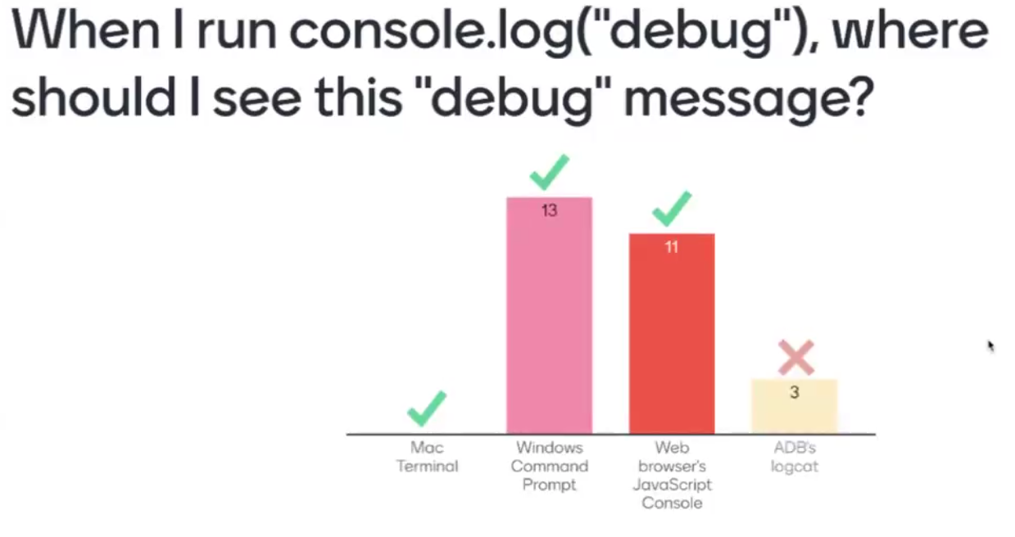

Slide 27
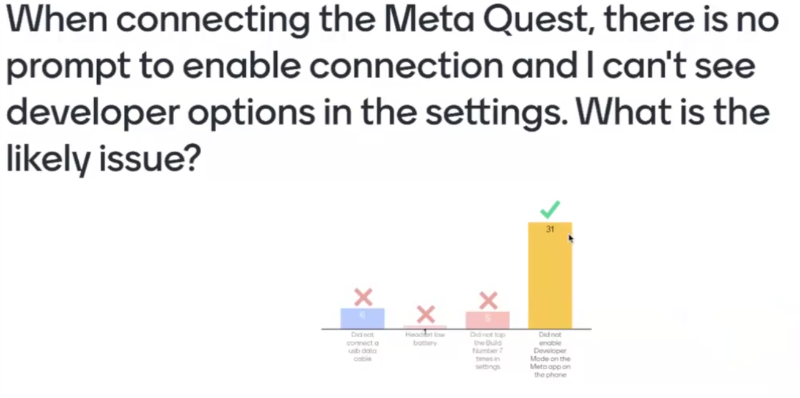
Did not enable Developer Mode on the Meta app on the phone

Slide 28
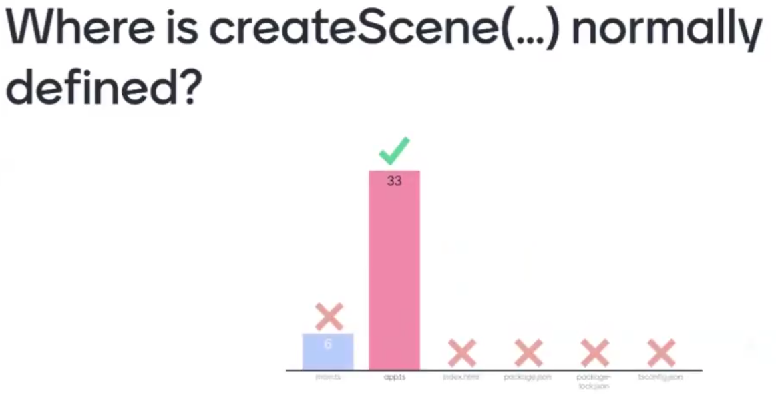
app.ts

Slide 29
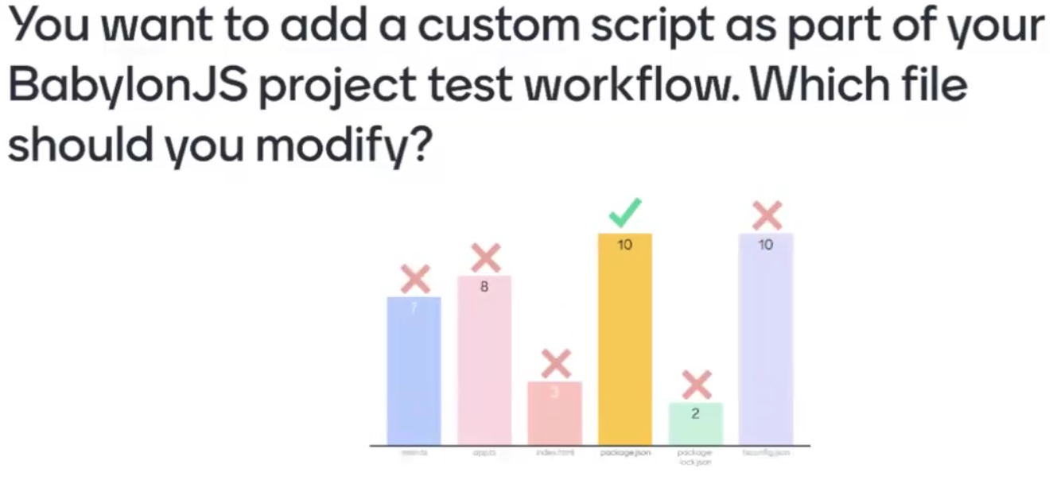
package.json

Slide 30
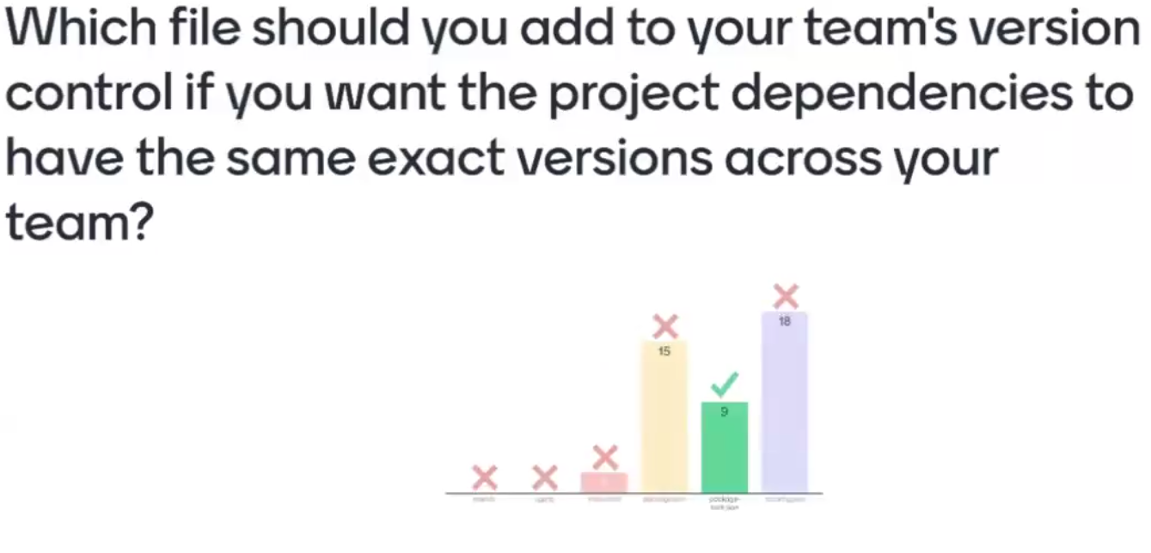
package-lock.json

Slide 31
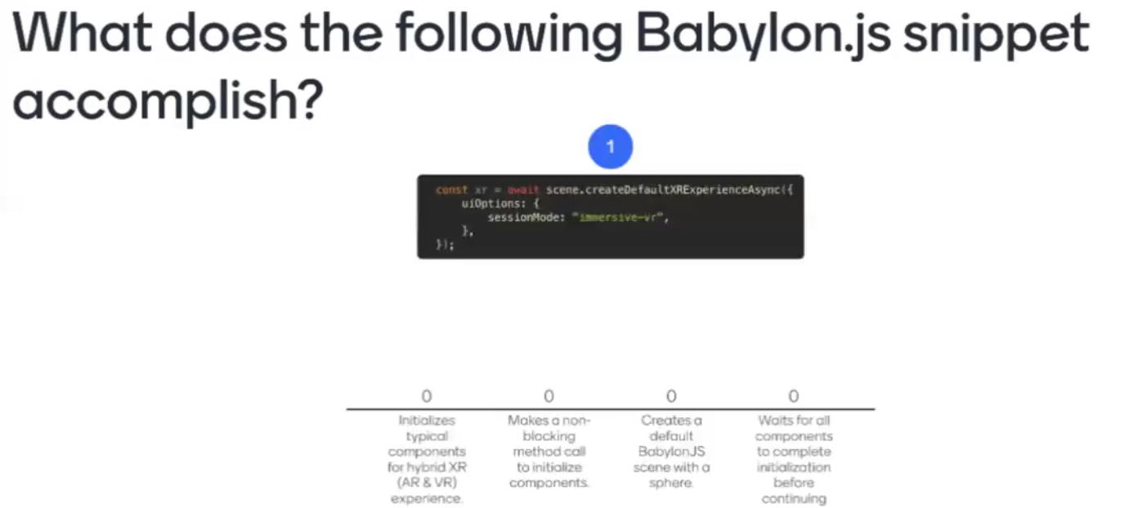
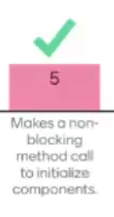

Slide 32
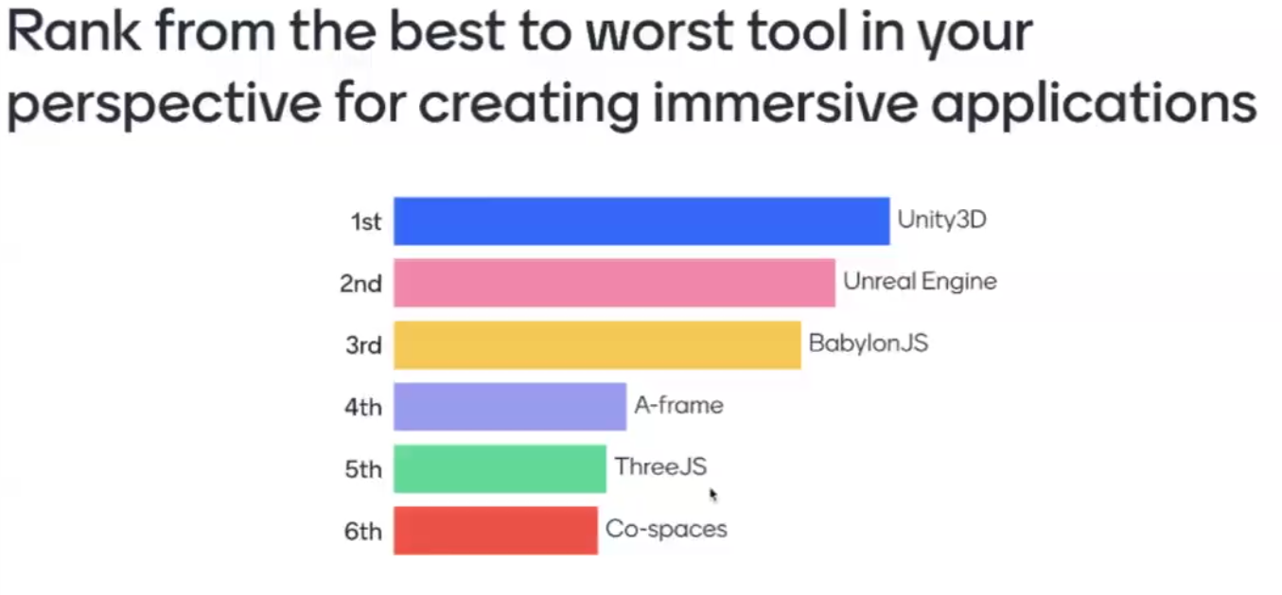

Slide 33
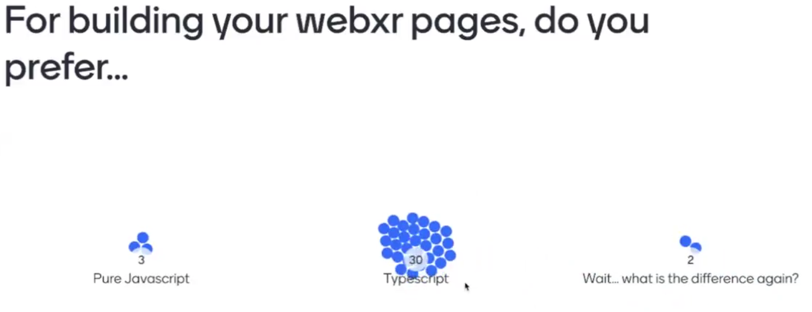
Coz we come from C++

Slide 34
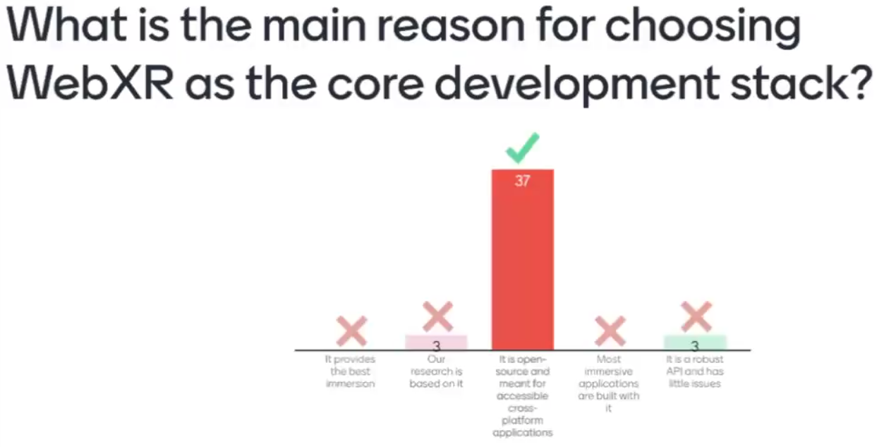

Slide 35
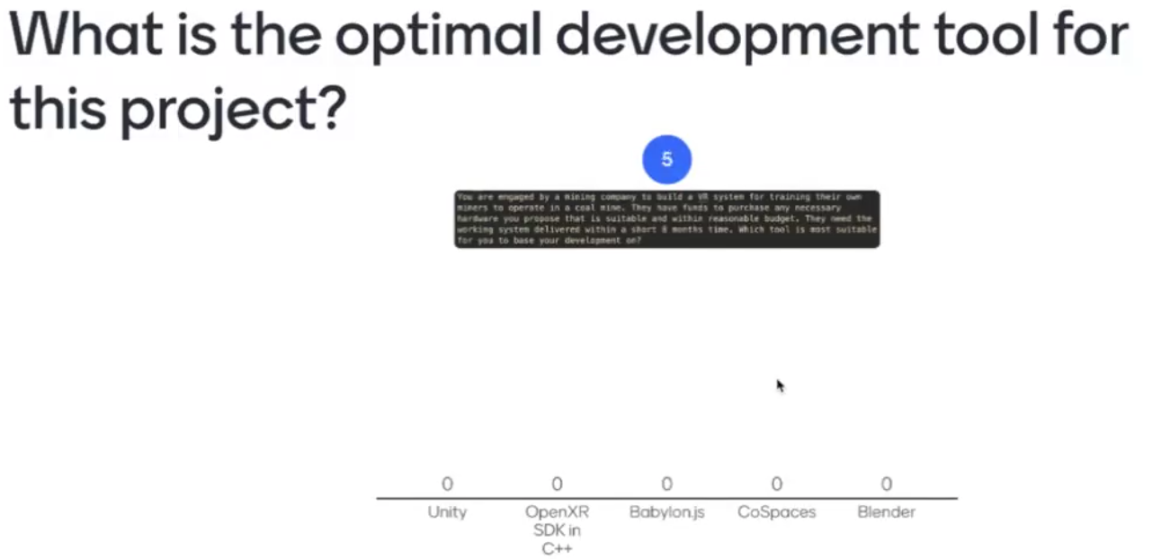
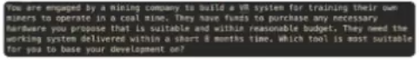
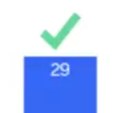
Mining simulator

Slide 36
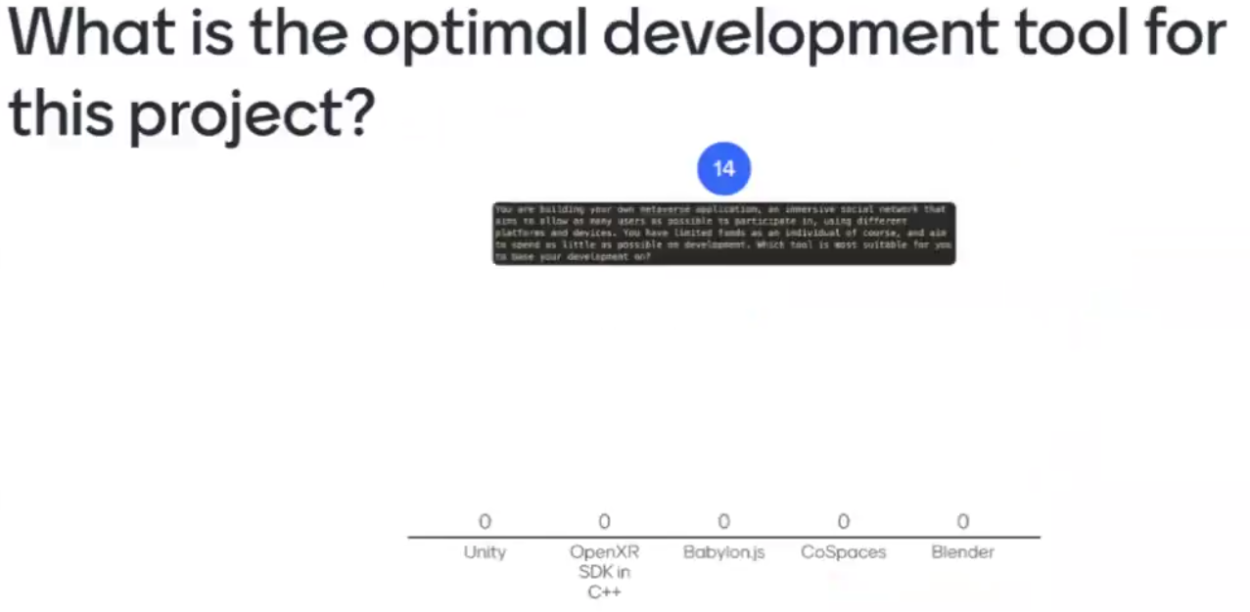
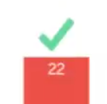
Metaverse app
Limited funds

Slide 37
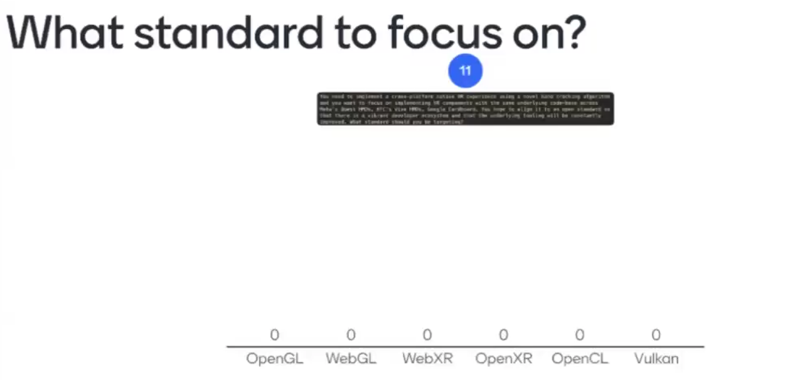
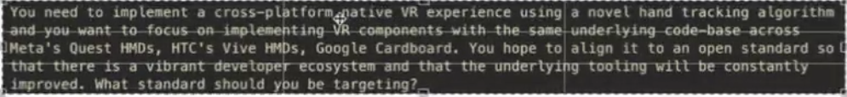
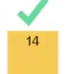
cross platform native VR experience using a novel hand tracking. focus on implementing VR components with the same underlying code base across all these different things, you hope to align it to an open standard so that there is a vibrant developer ecosystem. Constantly improve.

Slide 38
Lesson 5

Slide 39
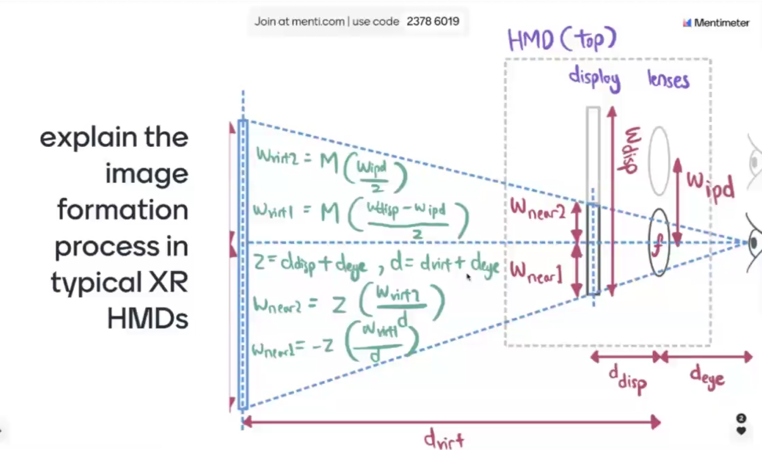

Slide 40
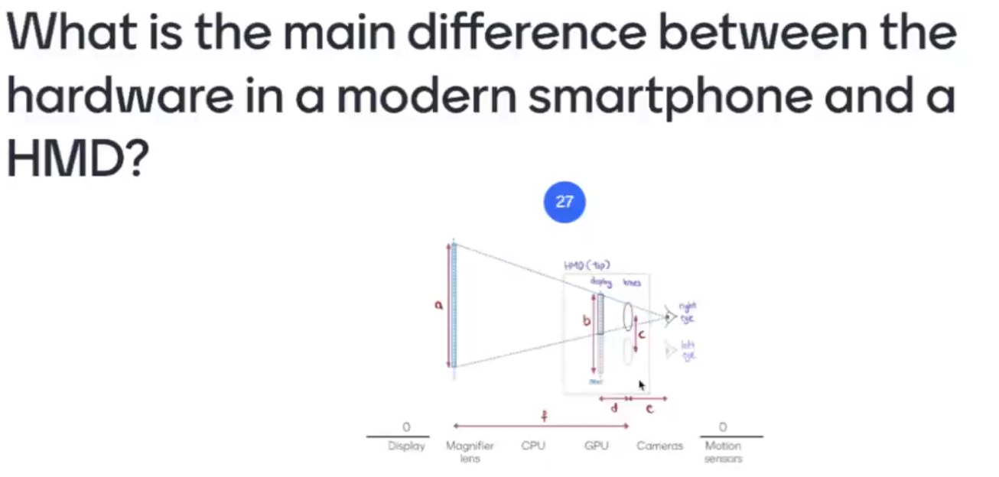
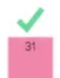

Slide 41
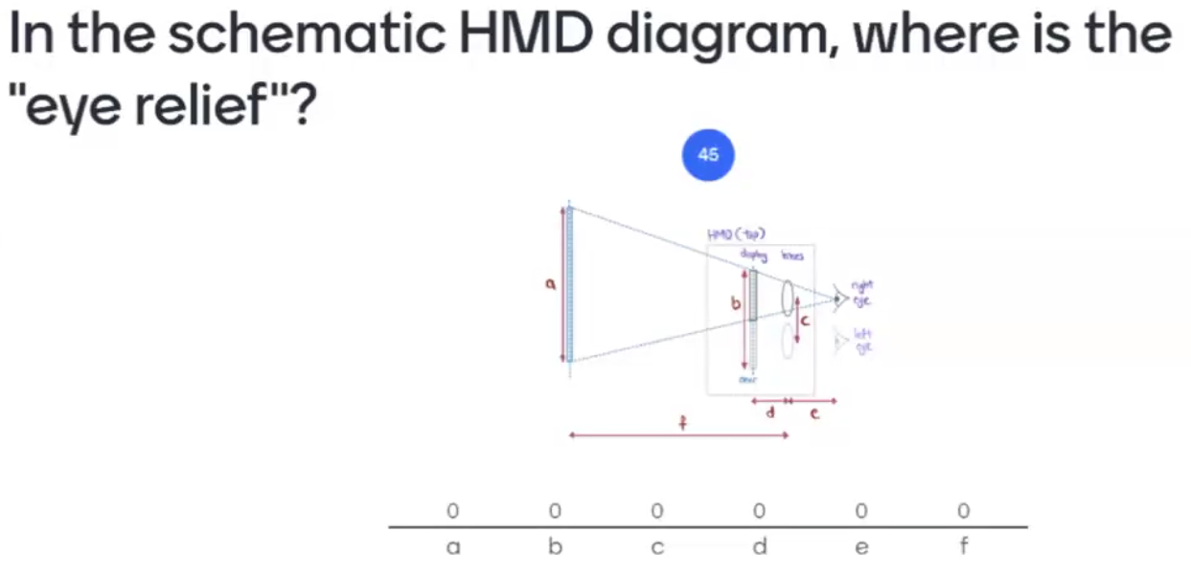
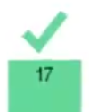

Slide 42
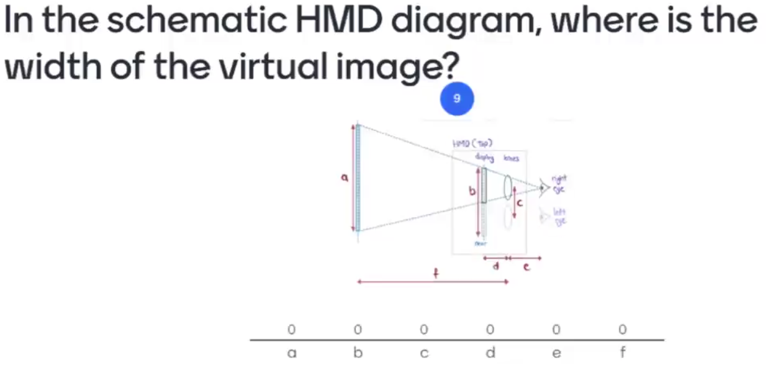
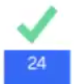

Slide 43





Slide 44



Slide 45



Slide 46



Slide 47



Slide 49



Slide 50



Slide 51


Ans: There are different virtual objects created at runtime

Slide 52
Lesson 6

Slide 53



Slide 54




Slide 55



Slide 56


Slide 57




Slide 58



Slide 59



Slide 60



Slide 61


Slide 62


